Slide 1
Diabetes treatment and possible factors affecting its effectiveness
Web Scraping Project
By
Oluwole Alowolodu

Slide 2
Outline
Introduction
Scrapy and Website
Methods
Data visualization
Discussion & Conclusion

Slide 3
Diabetes
8.5% prevalence in adult population
In US, (9.4% ) 30.3 million people live with diabetes according to CDC
Avandia Oral
Metformin
Invokana

Slide 4

Method – WebMD $ Scrapy
WebMD is an online source for health-related information
Suitable for this project because it lists medical conditions and drugs
Huge user review database which includes;
Medical condition
Date
Duration of treatment
Age range of user
Gender
Ratings based on effectiveness, ease of use and satisfaction
Comments
Scrapy, an open source web scraping framework was used to extract data of 3 diabetes drug.

Slide 5
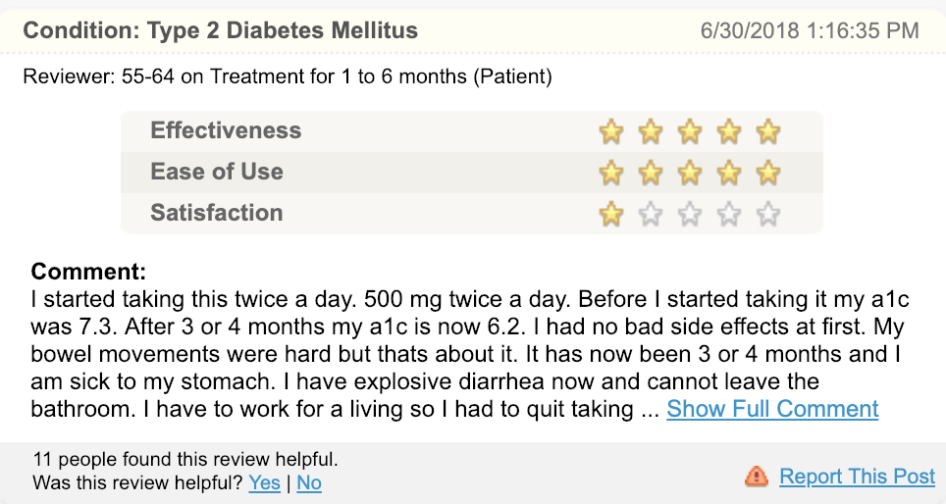

Slide 6
Avandia Oral

Slide 7
Metformin

Slide 8
Invokana

Slide 9
Visualization of possible factors –Avandia oral

Slide 10
Visualization of possible factors –Metformin

Slide 11
Visualization of possible factors - Invokana

Slide 12
Discussion
As displayed in the plots, the data collected and analyzed indicates the demographic make-up of most diabetes patients are mostly between the ages of 45-74, and females.

Slide 13
Discussion
Various factors may have contributed to the ratings by the public, particularly the effectiveness ratings of the treatment, however, duration of treatment tends to be directly proportional to effectiveness.
Future analyses should include sentiment analyses of comments submitted to observe if there is a trend or repeated reason for non-continuation of treatment.

